Slide 1


Titolo presentazione sottotitolo
Group 1, variant 1
Developement of a 3D environment sampling device
Milano, XX mese 20XX
Beatrice Pedretti, Mauro di Liddo, Davide Goshen

Slide 2
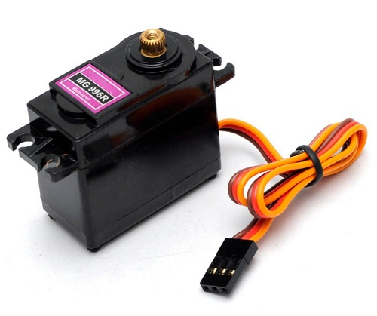
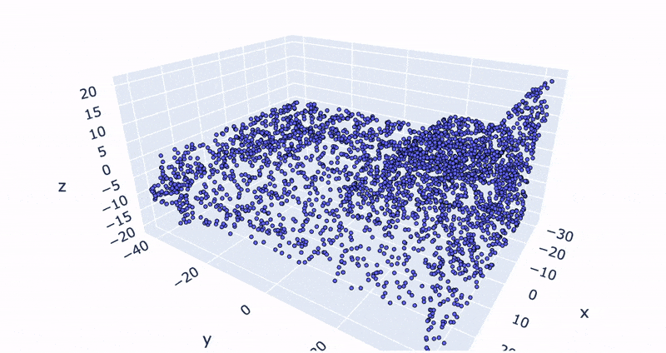
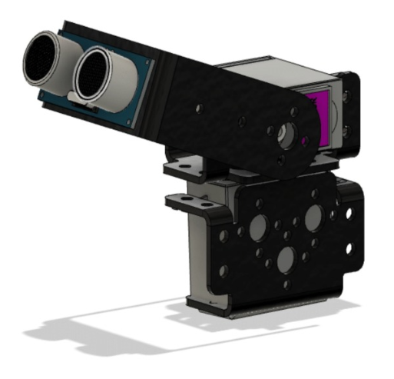


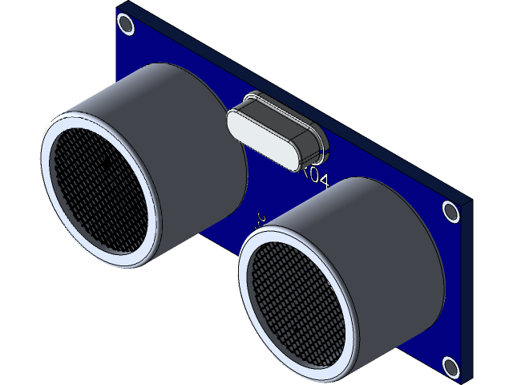
Aim of the project
2
Di Liddo, Goshen, Pedretti

Slide 3
Requirements: hardware
3
High-Torque digital servo motors:
Stall torque: 10 kg
Movement range: 180°
Operating voltage: 4.8 V a 7.2 V
Running Current 500 mA – 900 mA (6 V)
Weight: 55 g
MG996R
HCSR04
Connection elements
& breadbord
Cypress CY8CKIT-059
Wooden case
Di Liddo, Goshen, Pedretti

Slide 4
Requirements: hardware
4
Ultrasonic ranging module:
Measured distance range: 2 cm – 400 cm
Working voltage: DC 5 V
Working current: 15 mA
Working frequency: 40 Hz
Measuring angle: 15°
MG996R
HC SR04
Connection elements
& breadbord
Cypress CY8CKIT-059
Wooden case
Di Liddo, Goshen, Pedretti

Slide 5
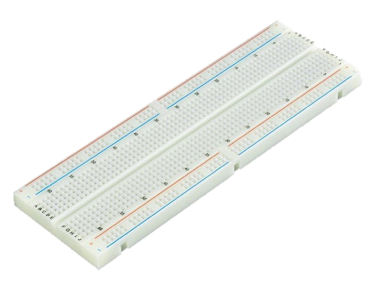
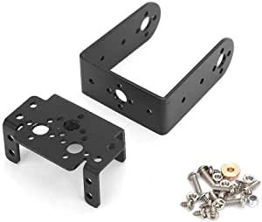
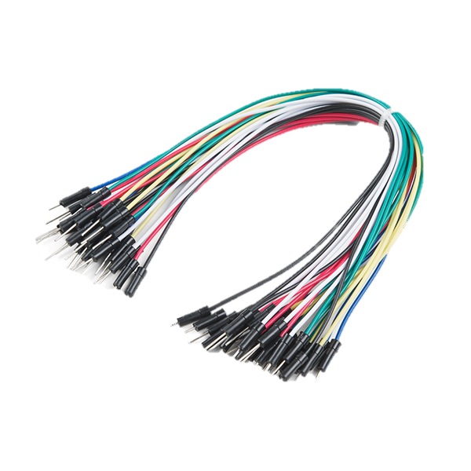
Requirements: hardware
5
MG996R
HCSR04
Breadboard
Jumper wires
Handmade aluminium support
Metal supports
Copper wire for electrical insulation
Connection elements
& breadbord
Cypress CY8CKIT-059
Wooden case
Di Liddo, Goshen, Pedretti

Slide 6
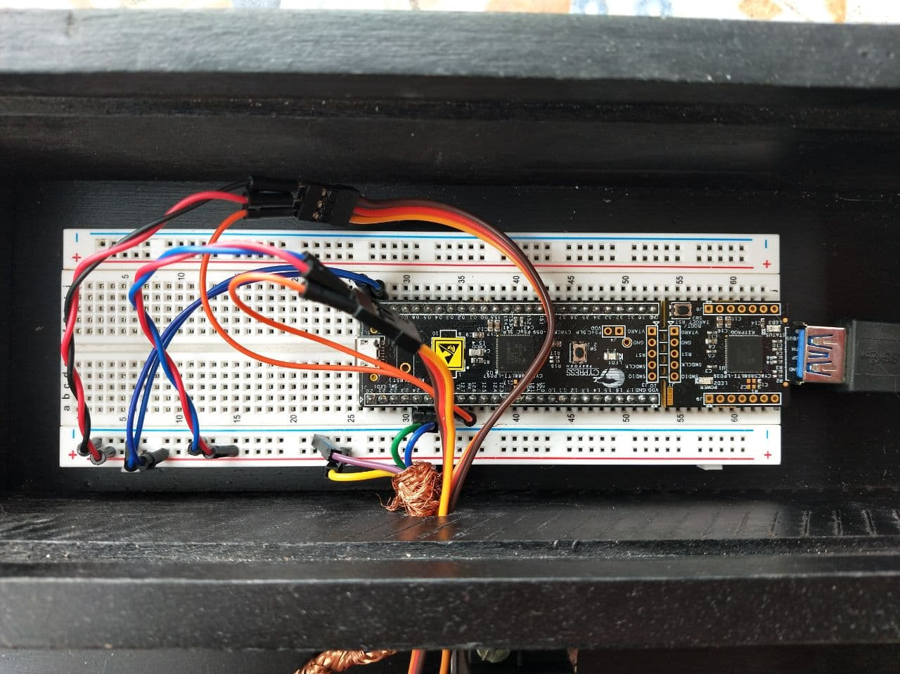
Requirements: hardware
6
Wiring configuration
MG996R
HCSR04
Connection elements
& breadbord
Cypress CY8CKIT-059
Wooden case
Di Liddo, Goshen, Pedretti

Slide 7
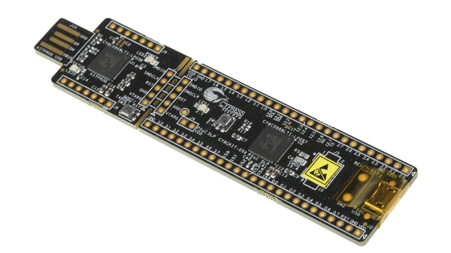
Requirements: hardware
7
MG996R
HCSR04
Connection elements
& breadbord
Cypress CY8CKIT-059
Wooden case
Di Liddo, Goshen, Pedretti

Slide 8
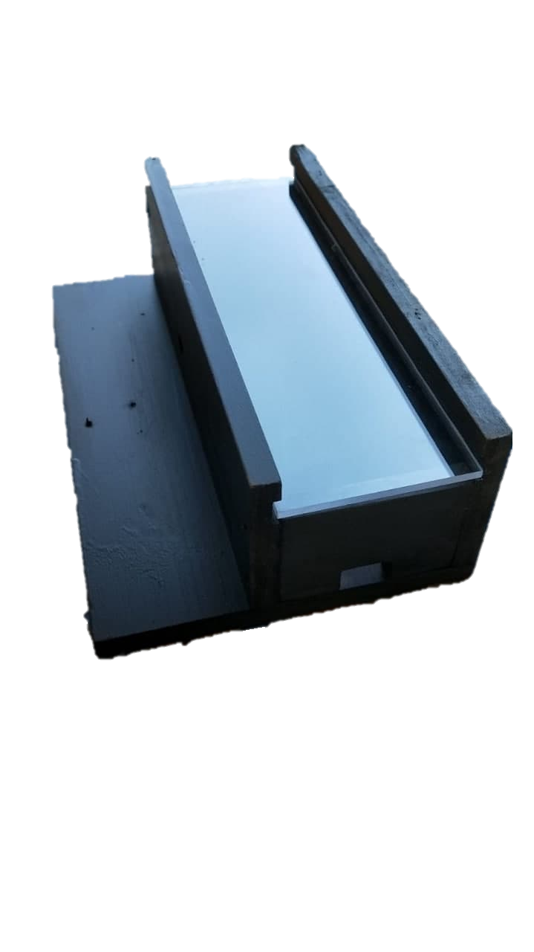
Requirements: hardware
8
MG996R
HCSR04
Connection elements
& breadbord
Cypress CY8CKIT-059
Wooden case
Di Liddo, Goshen, Pedretti

Slide 9
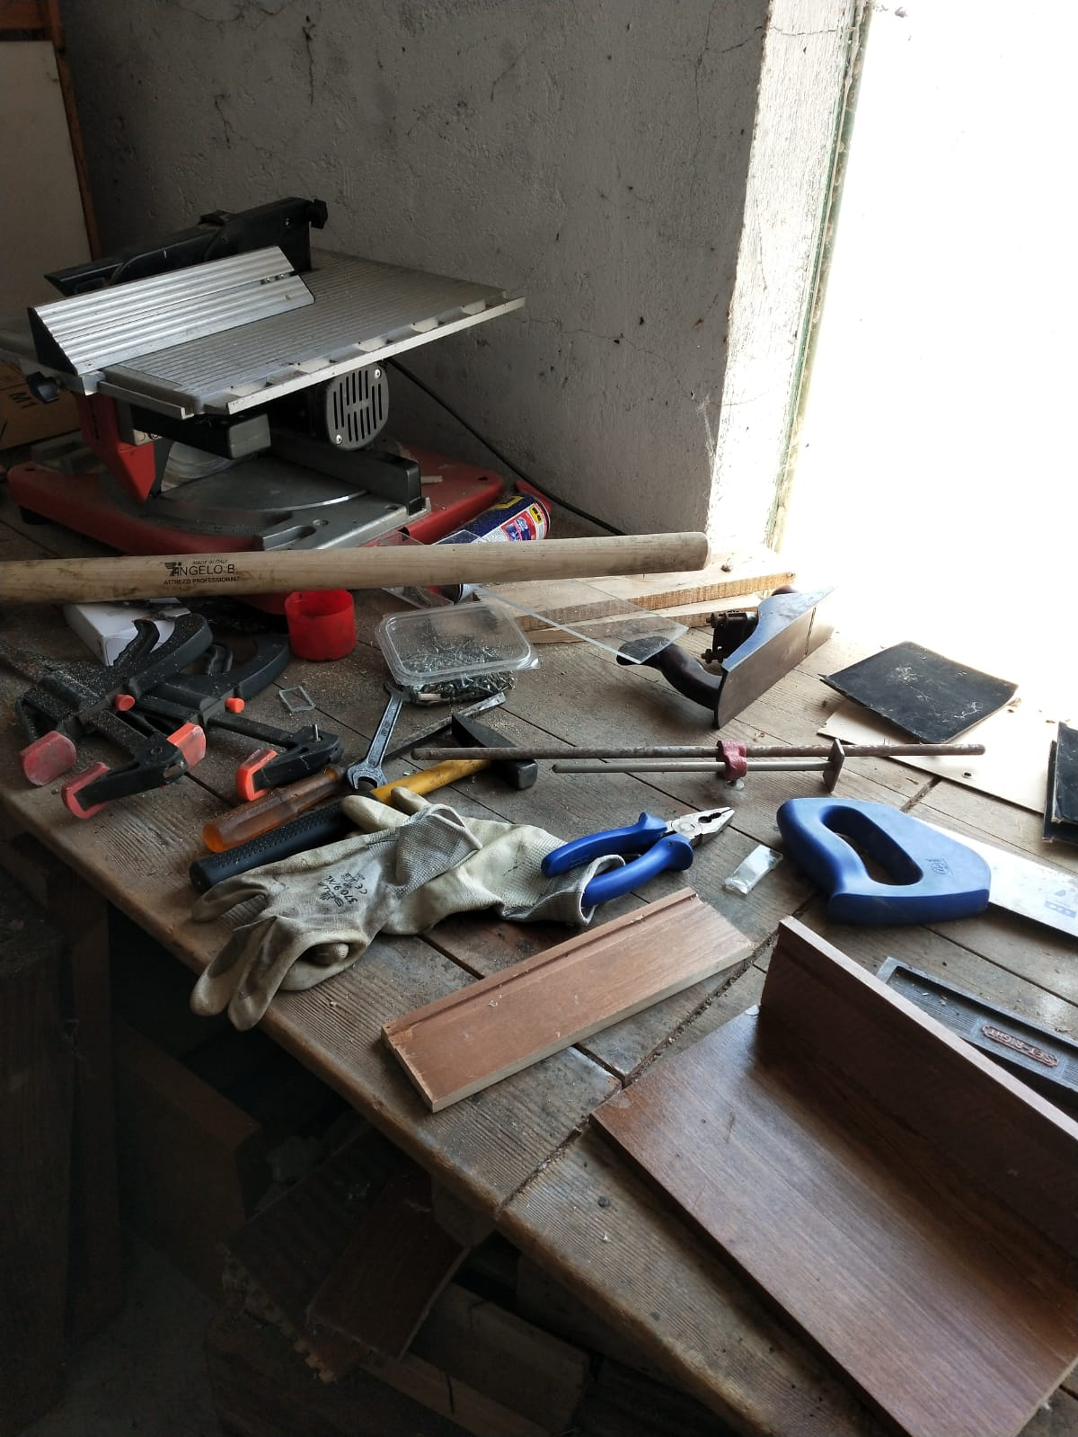
Requirements: hardware
9
MG996R
HCSR04
Connection elements
& breadbord
Cypress CY8CKIT-059
Wooden case
Di Liddo, Goshen, Pedretti

Slide 10
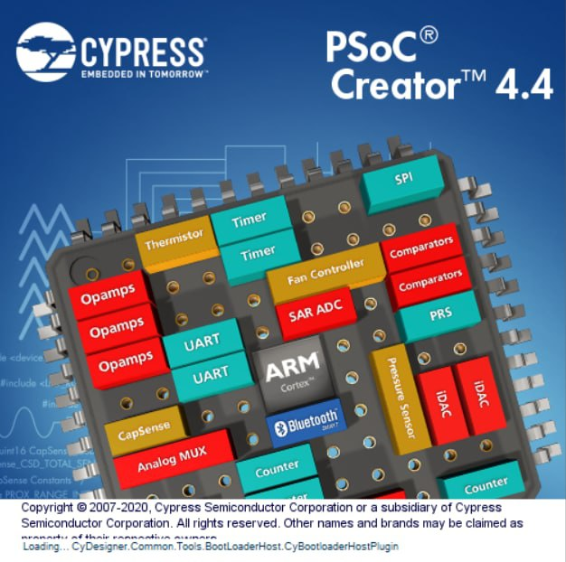




Requirements: software
10
PSoC Creator
Kivy
Visual Studio Code
MATLAB 2017b with Computer Vision Toolbox
Di Liddo, Goshen, Pedretti

Slide 11
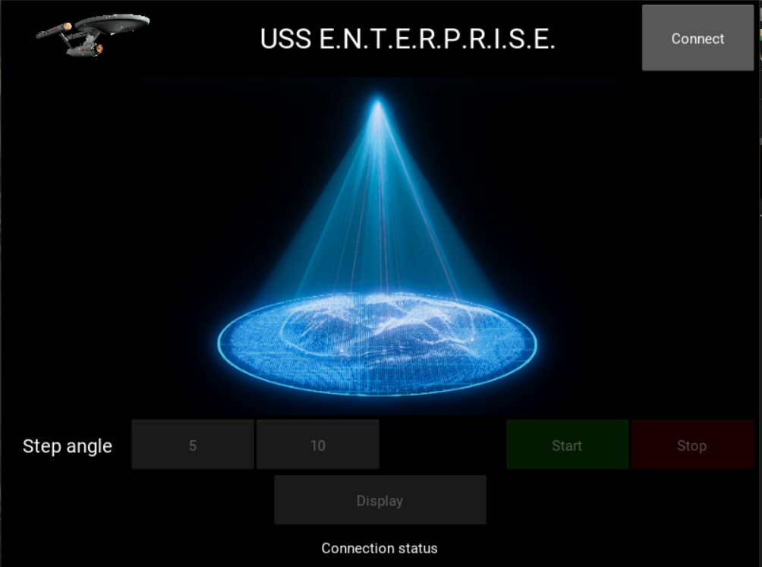
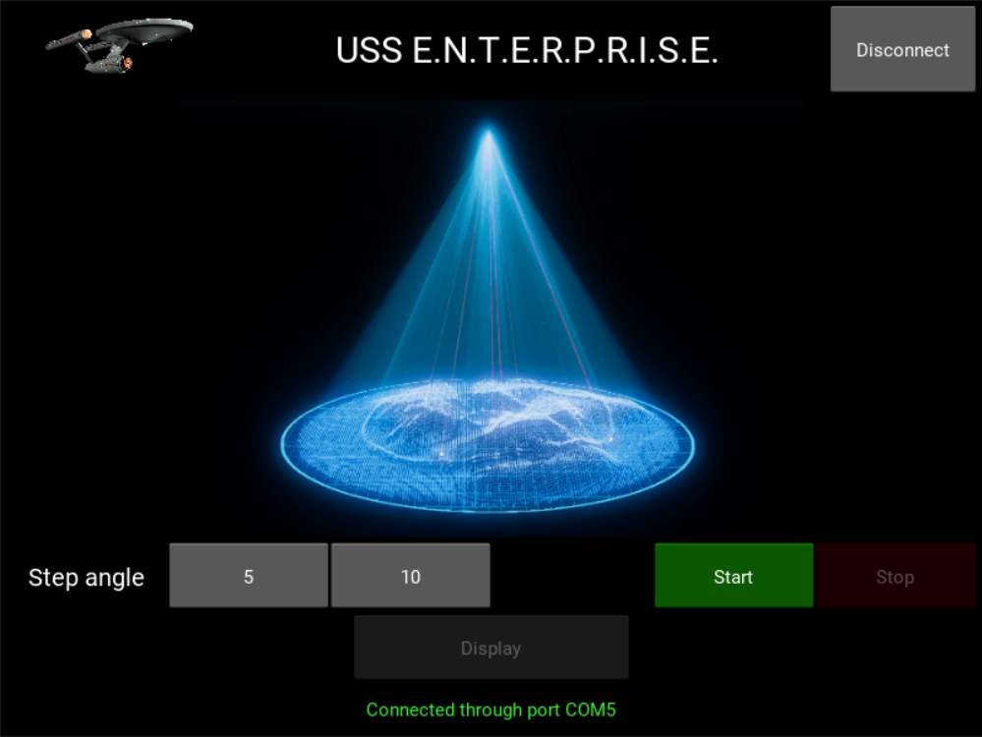
Requirements: software
11
PSoC Creator
Kivy
Visual Studio Code
MATLAB 2017b with Computer Vision Toolbox
Di Liddo, Goshen, Pedretti

Slide 12

Requirements: software
12
PSoC Creator
IDE
Kivy
Visual Studio Code
MATLAB 2017b with Computer Vision Toolbox
Di Liddo, Goshen, Pedretti

Slide 13
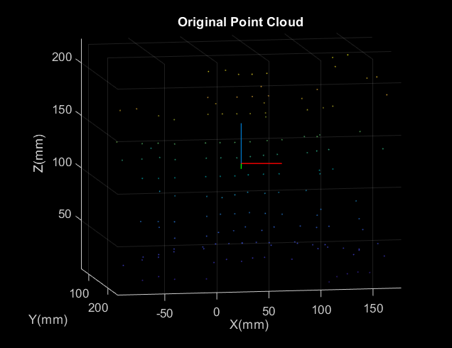
Requirements: software
13
PSoC Creator
Kivy
Visual Studio Code
MATLAB 2017b with Computer Vision Toolbox
Di Liddo, Goshen, Pedretti

Slide 14
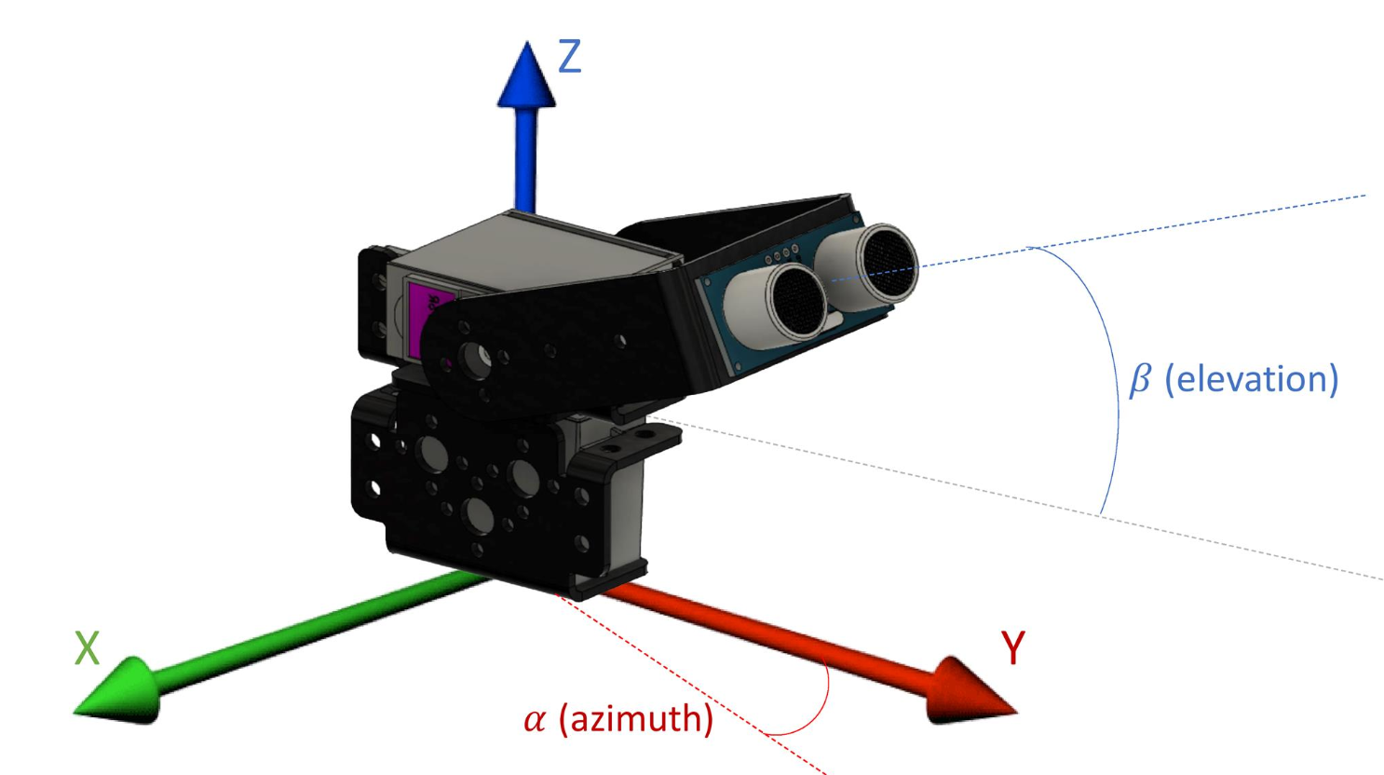
Calibration
14
First servomotor:
0 angle: lies on the positive portion of the X-axis
90 angle: lies on the positive portion of the Y-axis
180 angle: lies on the negative portion of the X-axis
Second servomotor:
0 angle: 60° angle between the Z-axis and the straight line which is the extension of the arm to which the sonar is linked.
90 angle: 0 angle + 90° = 150° (almost)
Di Liddo, Goshen, Pedretti

Slide 15
Calibration
15
SERVO_MID_ANGLE = 90
ANGLE_ZERO = 60
alpha = SERVO_MID_ANGLE - Servo_GetPosition1()
beta = Servo_GetPosition2() + ANGLE_ZERO-SERVO_MID_ANGLE
Di Liddo, Goshen, Pedretti

Slide 16
Coordinates computation
16
D2: distance between the middle of the crankshaft of the second servomotor and the Z-axis
ARM_LENGTH: length of the connection component that allows the rotation of the sonar solidally with the second crankshaft
D2
ARM_LENGTH
Z1
Z1 is the height of the crankshaft of the second servomotor
pos_servo1_rad: alpha in rad
pos_servo2_rad: beta in rad
pos_servo2_z_rad: beta + ANGLE_ZERO (rad)
Di Liddo, Goshen, Pedretti

Slide 17
Coordinates computation
17
D2
ARM_LENGTH
Z1
X = (D2 + (ARM_LENGTH + distance_real) * cos(pos_servo2_rad)) * sin(pos_servo1_rad); Y = (D2 + (ARM_LENGTH + distance_real) * cos(pos_servo2_rad)) * cos(pos_servo1_rad); Z = Z1 - (ARM_LENGTH + distance_real) * cos(pos_servo2_z_rad);
Di Liddo, Goshen, Pedretti

Slide 18
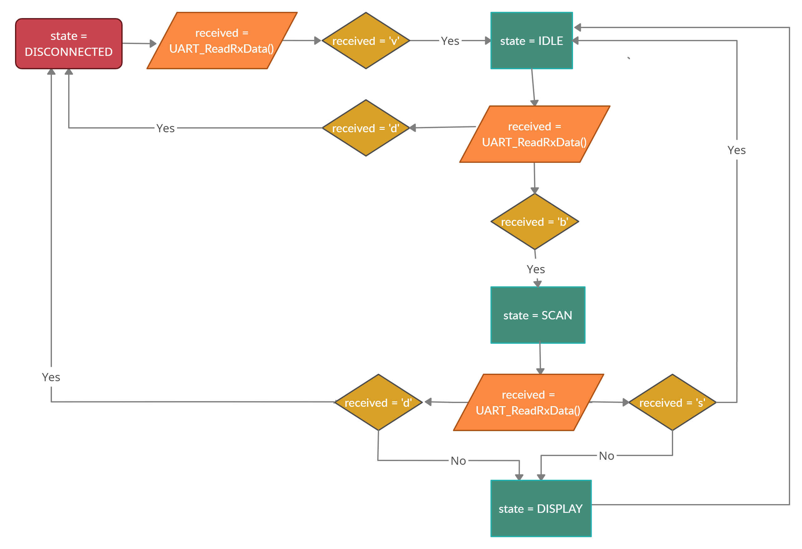
Finite-states machine
18
Di Liddo, Goshen, Pedretti

Slide 19
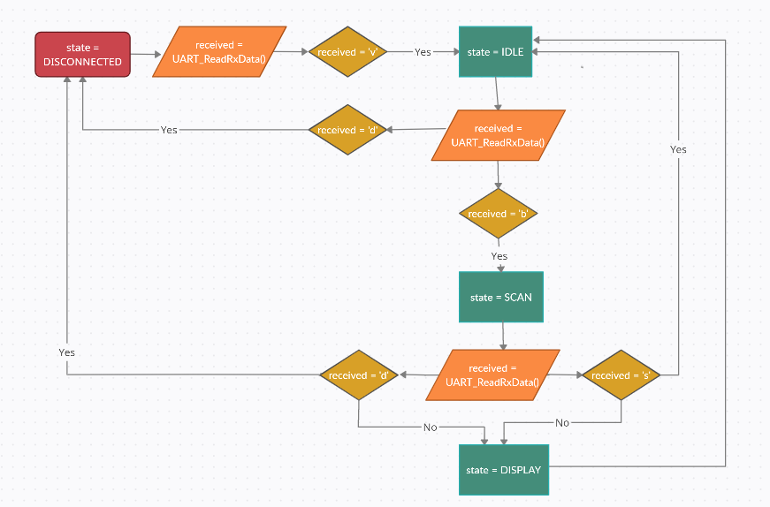
Finite-states machine
19
Di Liddo, Goshen, Pedretti

Slide 20
State: IDLE
20
Wait for start
(if first connection, start components)
Modify angular steps:
- 5° (default)
- 10°
Reset variables
Di Liddo, Goshen, Pedretti

Slide 21
Finite-states machine
21
Di Liddo, Goshen, Pedretti

Slide 22
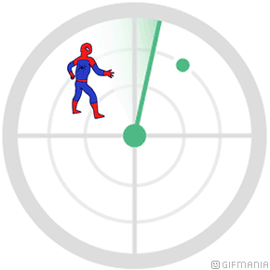
State: SCAN
22
Sweep of kinematic chain with one for cycle, switching directions and rising the scanner
2
For every step of the chain, check if returned servo angle is correct
3
If yes, compute coordinates (with limitations)
4
If the object is removed mid sweep, display reconstructed image immediately
5
Else, wait until scan is complete and then go to display
Di Liddo, Goshen, Pedretti

Slide 23
Finite-states machine
23
Di Liddo, Goshen, Pedretti

Slide 24
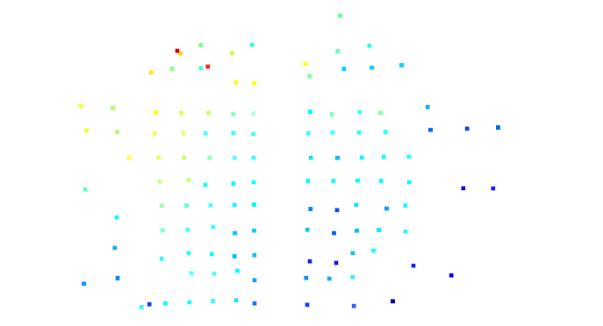
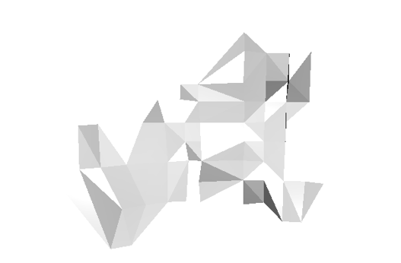
State: DISPLAY
24
Mainly performed in the GUI
Pop-up windows: point cloud and ballpoint mesh
On pression of ‘P’ key, a screenshot of the mesh is captured

Slide 25

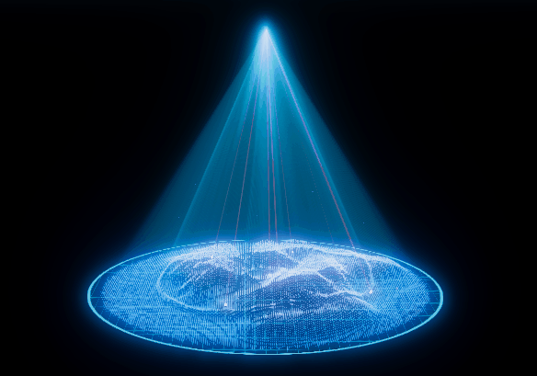
GUI
25
Python language and Kivy framework
UltraSound Sensor for
EnvironmeNT Recording and Point-cloud Reconstruction Integrated Scanning Equipment
Di Liddo, Goshen, Pedretti

Slide 26
GUI
26
Python language and Kivy framework
Connect/Disconnect button:
it sends the ‘v’ and ‘d’ letters over UART. PSoC is programmed to respond with a specific string, it allows automatical connection/disconnection
Di Liddo, Goshen, Pedretti

Slide 27
GUI
27
Python language and Kivy framework
Step angle
The user has the chance to change the angle step to:
5 degrees by pushing 5 (higher quality image)
10 degrees by pushing 10 (lower quality image)
Di Liddo, Goshen, Pedretti

Slide 28
GUI
28
Python language and Kivy framework
Start & Stop buttons
It sends over UART respectively ‘b’ and ‘s’. PSoC will recognize those letter and will manage the states progression.
Di Liddo, Goshen, Pedretti

Slide 29

GUI
29
Python language and Kivy framework
Display button
It starts the reconstruction of the image through a point cloud and a ballpoint algorithm
Di Liddo, Goshen, Pedretti

Slide 30
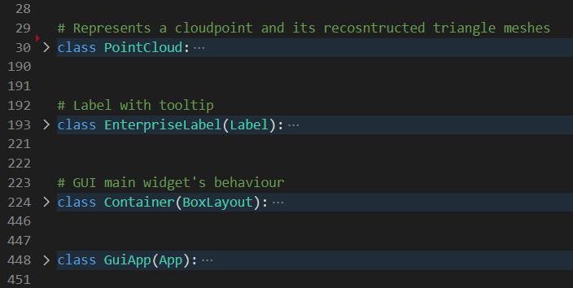
Python framework
30
Di Liddo, Goshen, Pedretti

Slide 31
Python framework
31
Graphic User Interface classes, managing visual elements on the screen
Di Liddo, Goshen, Pedretti

Slide 32
Python framework
32
Used by Kivy framework to create a program whose graphic representation is in GUI.kv file
Hierarchical description of the various windows
Di Liddo, Goshen, Pedretti

Slide 33
Python framework
33
Main GUI window:
__init__
on_press buttons: «binding» between element and event (NB. use separate threads)
connectionProcess
step_setter
startProcess
stopProcess
Di Liddo, Goshen, Pedretti

Slide 34
Python framework
34
Wrapper for open3d framework in easier interface
Takes as input a 3 columns vector; each row is a point read by numpy with np.loadtxt(file).
ballpoint
cloud_output, ballpoint_output_png, ballpoint_write
cloud_visualize, ballpoint_visualize
Di Liddo, Goshen, Pedretti

Slide 35

Image reconstruction
35
XYZ over UART
Di Liddo, Goshen, Pedretti

Slide 36
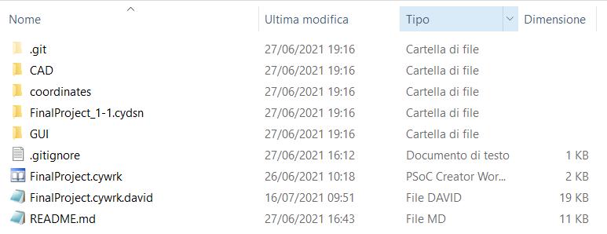
Image reconstruction
36
XYZ coordinates saved into .xyz file
Di Liddo, Goshen, Pedretti

Slide 37
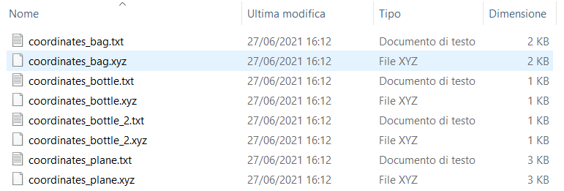
Image reconstruction
37
XYZ coordinates saved into .xyz file
Di Liddo, Goshen, Pedretti

Slide 38

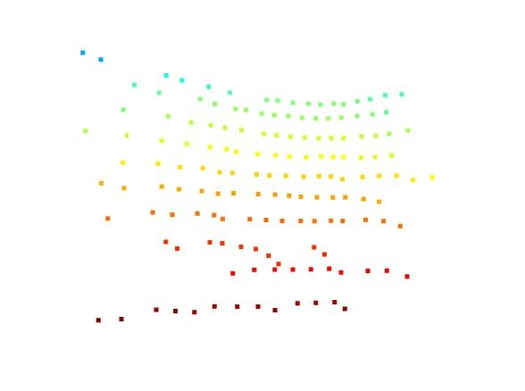
Image reconstruction
38
3D Points cloud
Di Liddo, Goshen, Pedretti

Slide 39
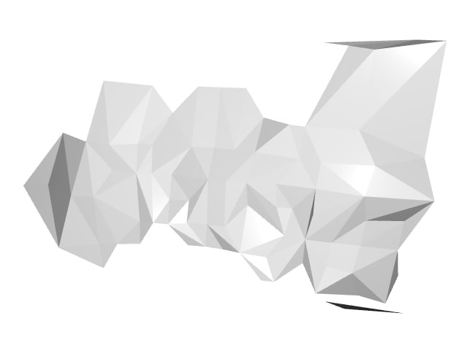
Image reconstruction
39
3D mesher
Di Liddo, Goshen, Pedretti

Slide 40



Conclusions: distance suggestion & limits
40
Unsufficient distance
Di Liddo, Goshen, Pedretti

Slide 41
Conclusions: distance suggestion & limits
41
Sufficient distance
Di Liddo, Goshen, Pedretti

Slide 42
Conclusions: distance suggestion & limits
42
In order to decrease the undected portion we have to increase the distance
Sufficient distance
Di Liddo, Goshen, Pedretti

Slide 43
Conclusions: distance suggestion & limits
43
In order to decrease the undected portion we have to increase the distance
Too high distance usually give us outliers
Sufficient distance
Di Liddo, Goshen, Pedretti

Slide 44

Conclusions: distance suggestion & limits
44
Compromised dimensions
Compromised distance: ~ 20 - 25 cm
Di Liddo, Goshen, Pedretti

Slide 45
Conclusions: limits
45
Distance and dimensions requirements in order to avoid outliers
Servo’s resolution: 1.2°
lowest integer step angle must be 2°
→ less points detected
Sonar returns correct distances only for points on planes parallel or almost parallel to it
Just one sonar to reconstruct an image.
Di Liddo, Goshen, Pedretti

Slide 46
Titolo presentazione sottotitolo
Thank you for your attention
Milano, XX mese 20XX

Slide 47
